Slide 1

Unit 2 - Lesson 1
Welcome to the Internet

Slide 2
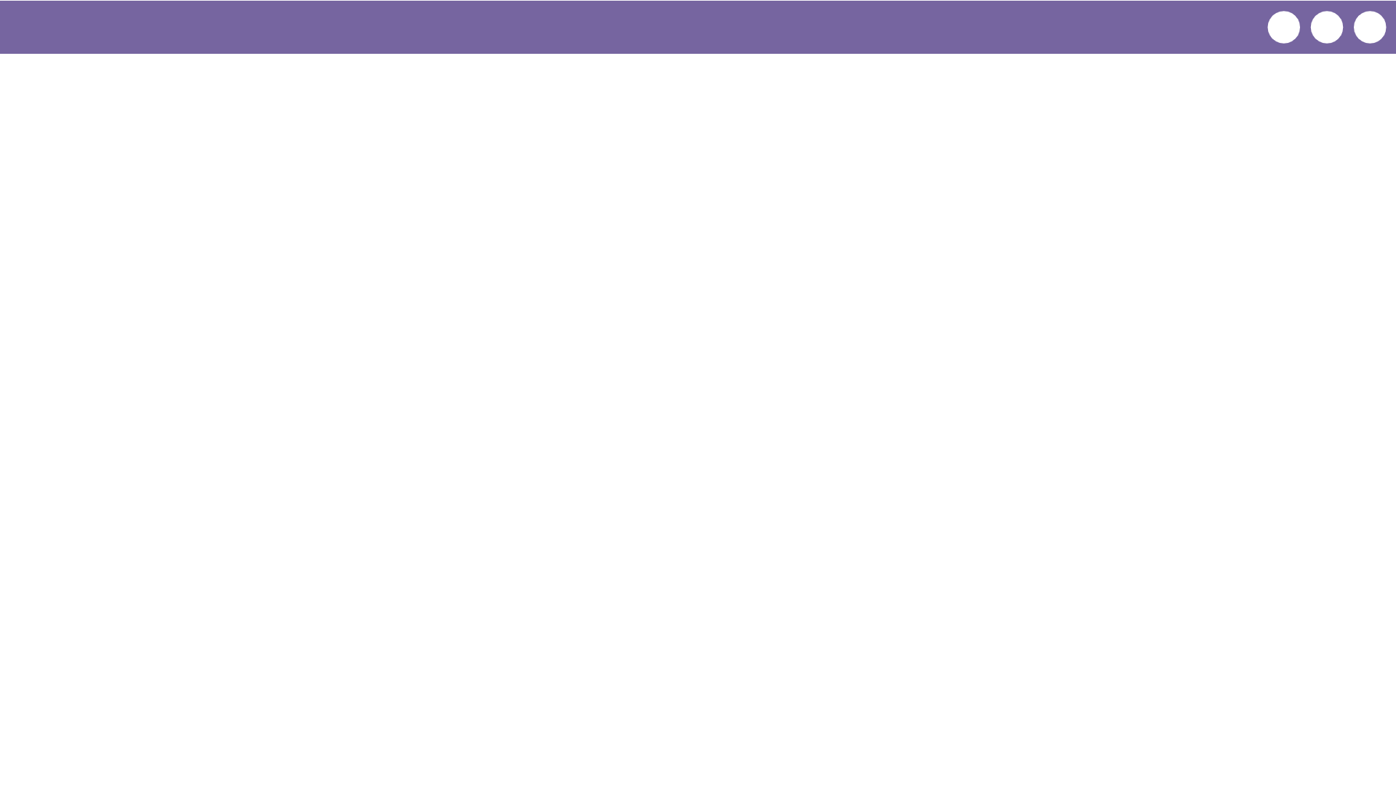
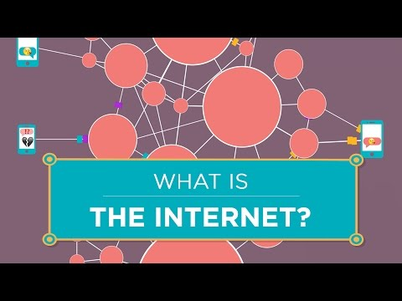
Unit 2 Lesson 1 - Wrap Up
Notes:
This slide contains a video for ‘What is the Internet’ from Code.org’s Youtube channel

Slide 3
Unit 2 - Lesson 2
Building a Network

Slide 4
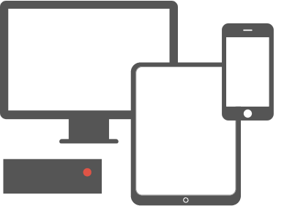
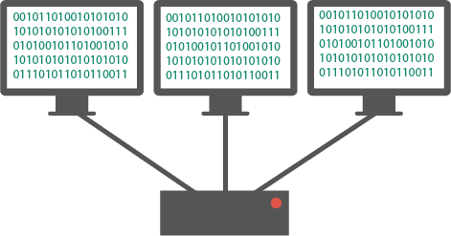
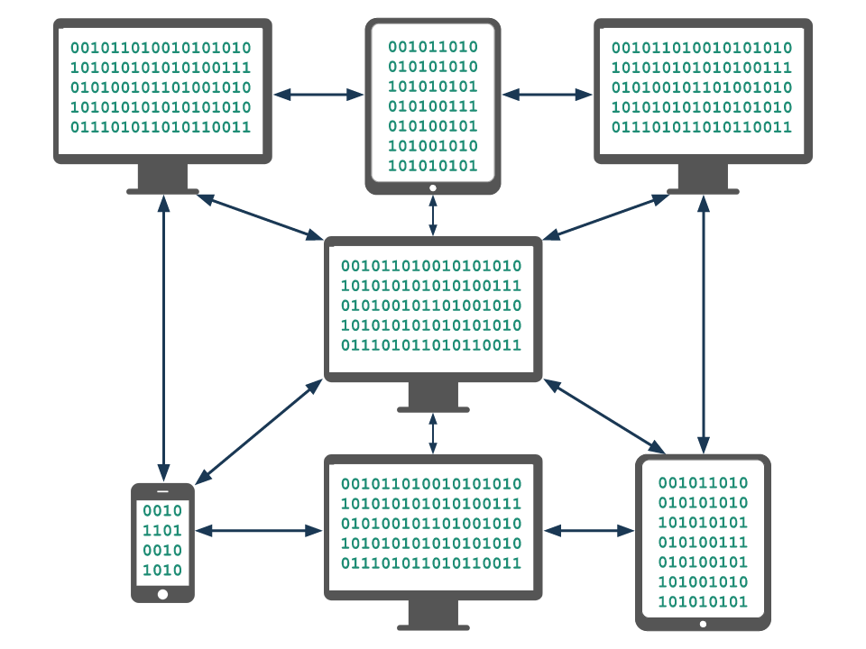
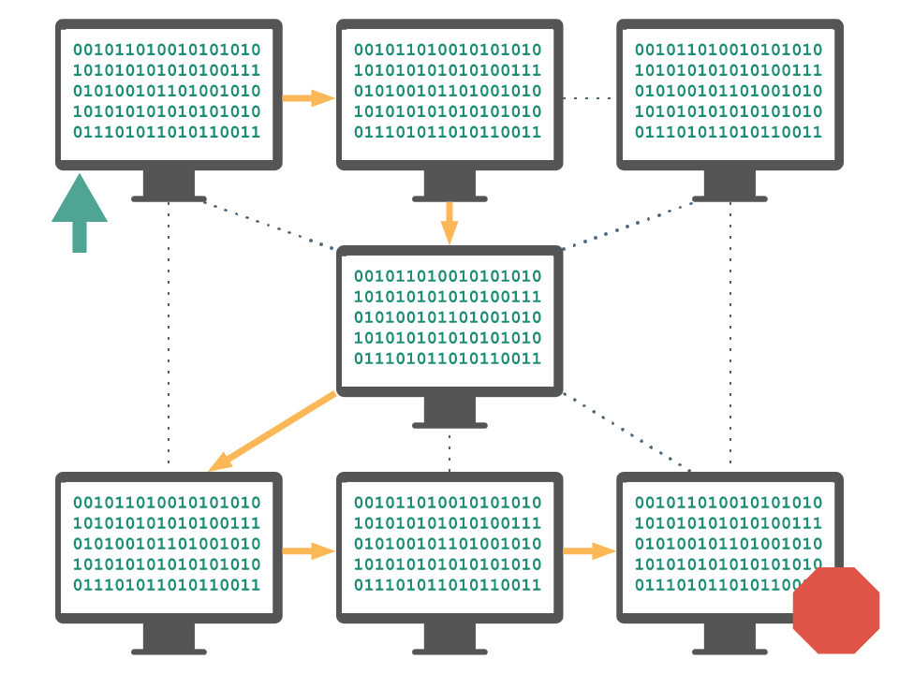
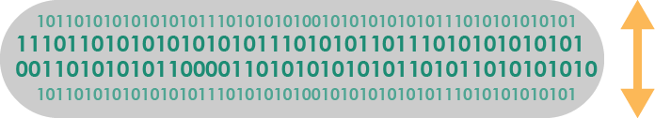
Unit 2 Lesson 2 - Wrap Up
Computing Device: a machine that can run a program, including computers, tablets, servers, routers, and smart sensors
Computing System: a group of computing devices and programs working together for a common purpose
Computing Network: a group of interconnected computing devices capable of sending or receiving data.
Path: the series of connections between computing devices on a network starting with a sender and ending with a receiver.
Bandwidth: the maximum amount of data that can be sent in a fixed amount of time, usually measured in bits per second.

Slide 5
Unit 2 - Lesson 3
The Need for Addressing

Slide 6
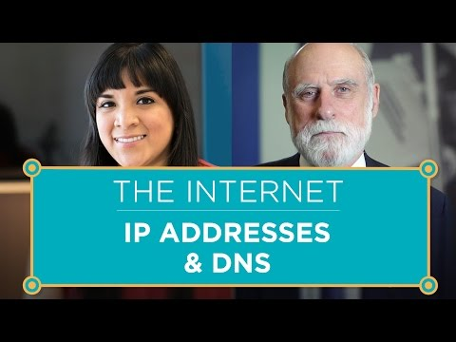
Unit 2 Lesson 3 - Wrap Up

Slide 7
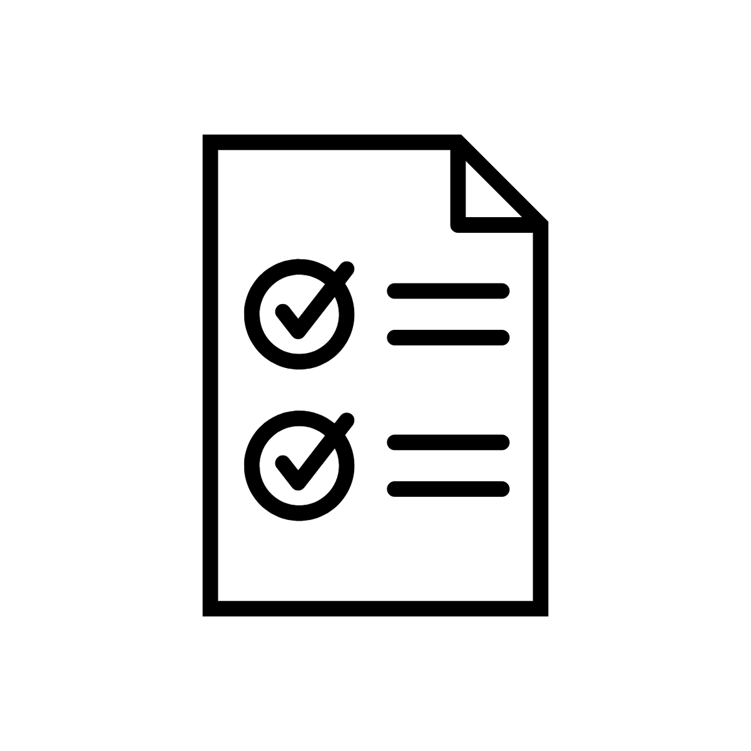

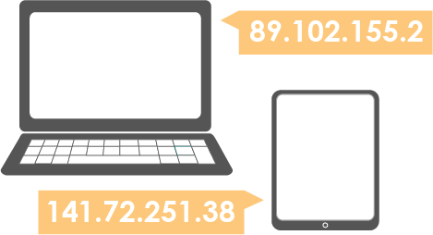
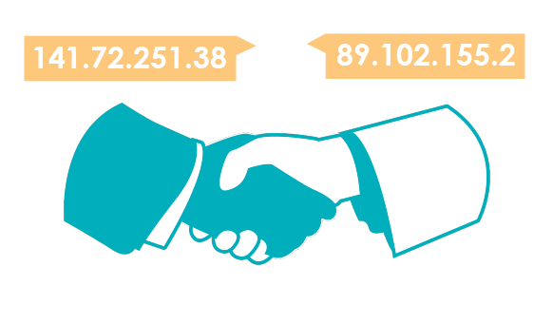
Unit 2 Lesson 3 - Wrap Up
Protocol: An agreed-upon set of rules that specify the behavior of some system
IP Address: The unique number assigned to each device on the Internet.
Internet Protocol (IP): a protocol for sending data across the Internet that assigns unique numbers (IP addresses) to each connected device

Slide 8
Unit 2 - Lesson 4
Routing & Redundancy

Slide 9
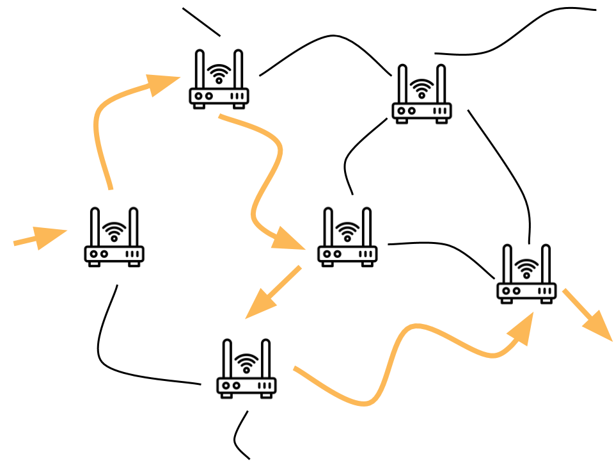

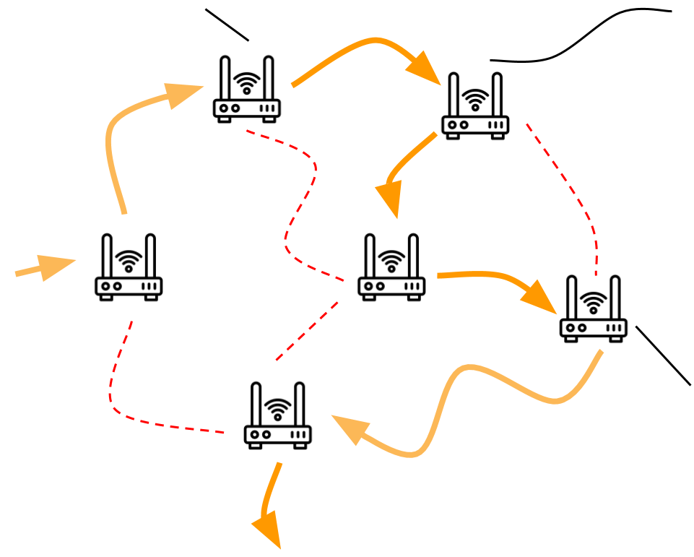
Unit 2 Lesson 4 - Wrap Up
Router: A type of computer that forwards data across a network
Redundancy: the inclusion of extra components so that a system can continue to work even if individual components fail, for example by having more than one path between any two connected devices in a network.
Fault Tolerant: Can continue to function even in the event of individual component failures. This is important because elements of complex systems like a computer network fail at unexpected times, often in groups.

Slide 10
Unit 2 - Lesson 5
Packets

Slide 11
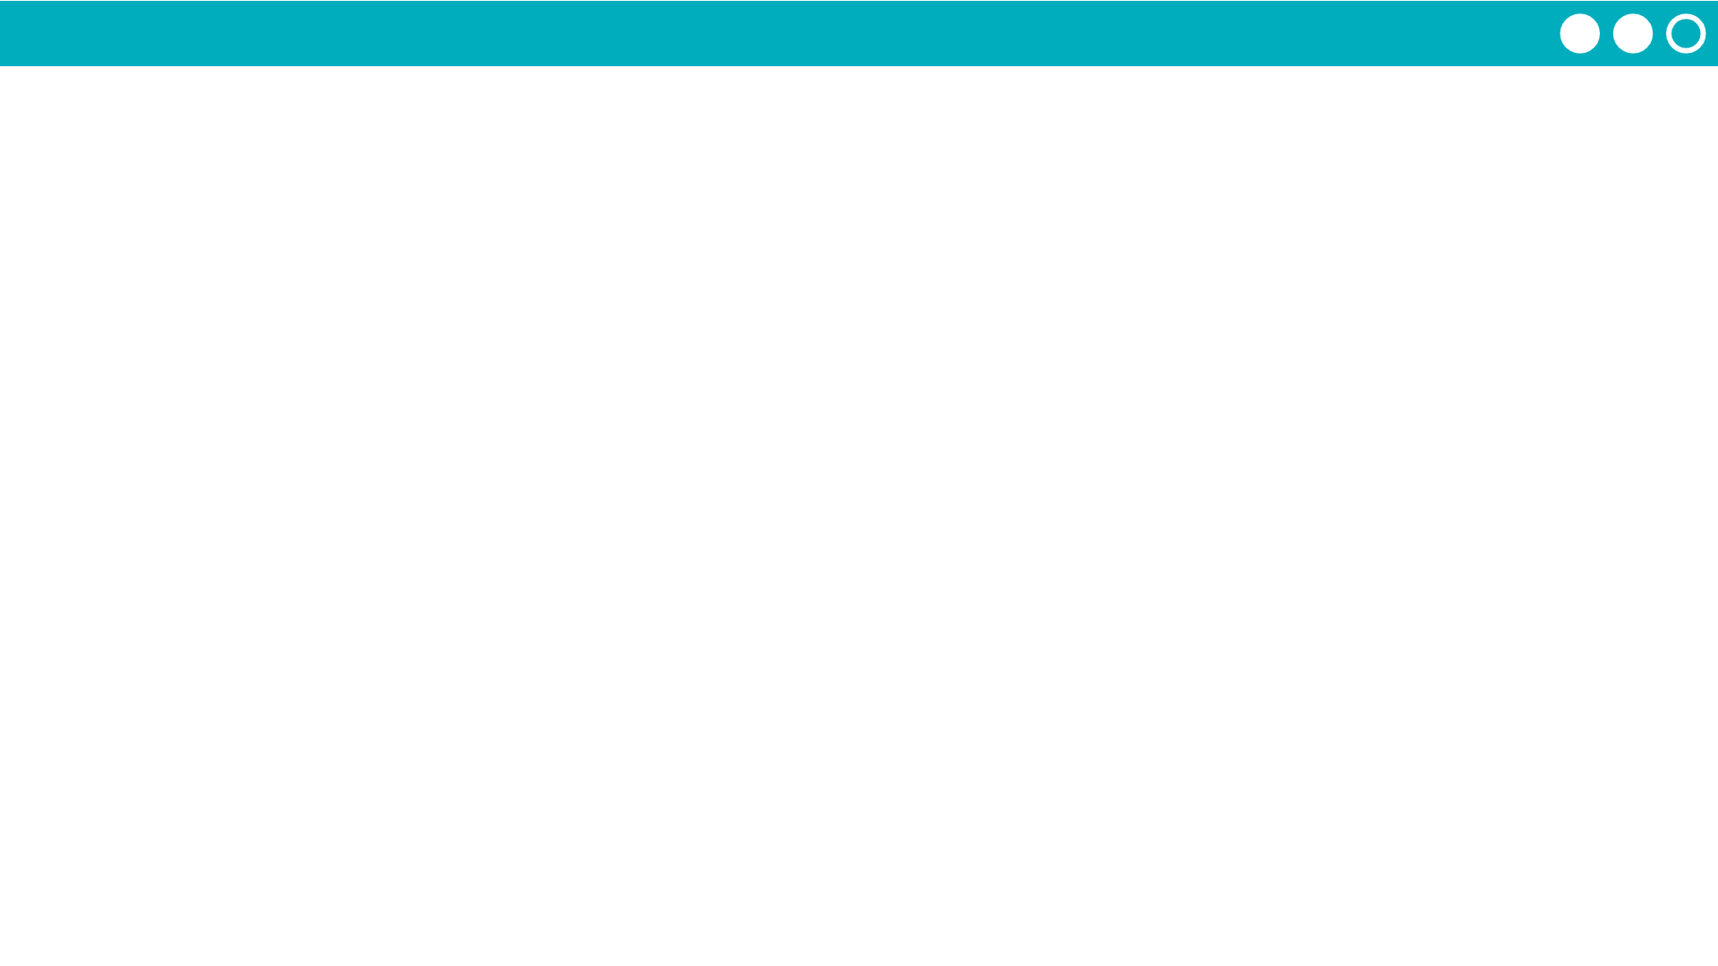
Unit 2 Lesson 5 - Activity
There’s two protocols commonly used to send packets online, and depending on the situation websites will choose the one that makes sense.
 | User Datagram Protocol (UDP) | Transmission Control Protocol (TCP)
Main Idea
Basics of how it works
Use in real life
Like Protocol 1 or clearing out the library as fast as you can. The goal is to send information quickly without worrying about accuray.
Like Protocol 2 or numbering every book in the library. It’s slower but more accurate.
Send all the packets but don’t check if they all get through or arrive in the right order.
Number packets so they can be re-ordered, confirm all were received, resend any missing packets. Multiple back and forth confirmations between sender and receiver.
Useful when split seconds matter more than correcting errors, like video-conferencing, live streaming, online gaming
Useful when accuracy matters more than saving a split second, like sending emails, photos, or just browsing websites

Slide 12
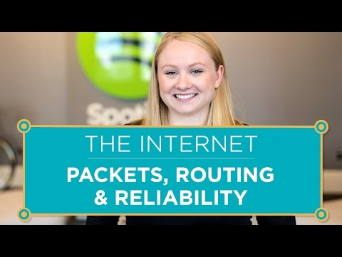
Unit 2 Lesson 5 - Wrap Up

Slide 13
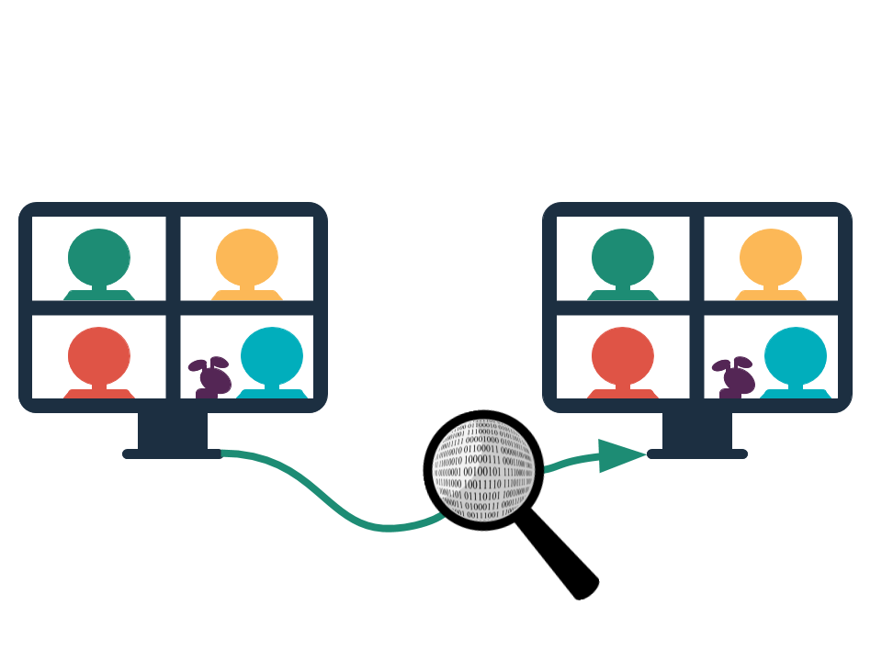
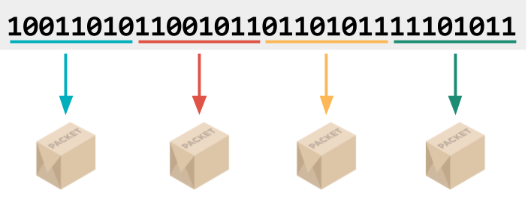
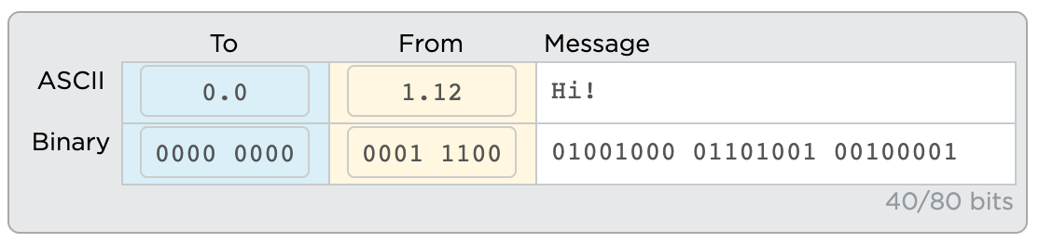
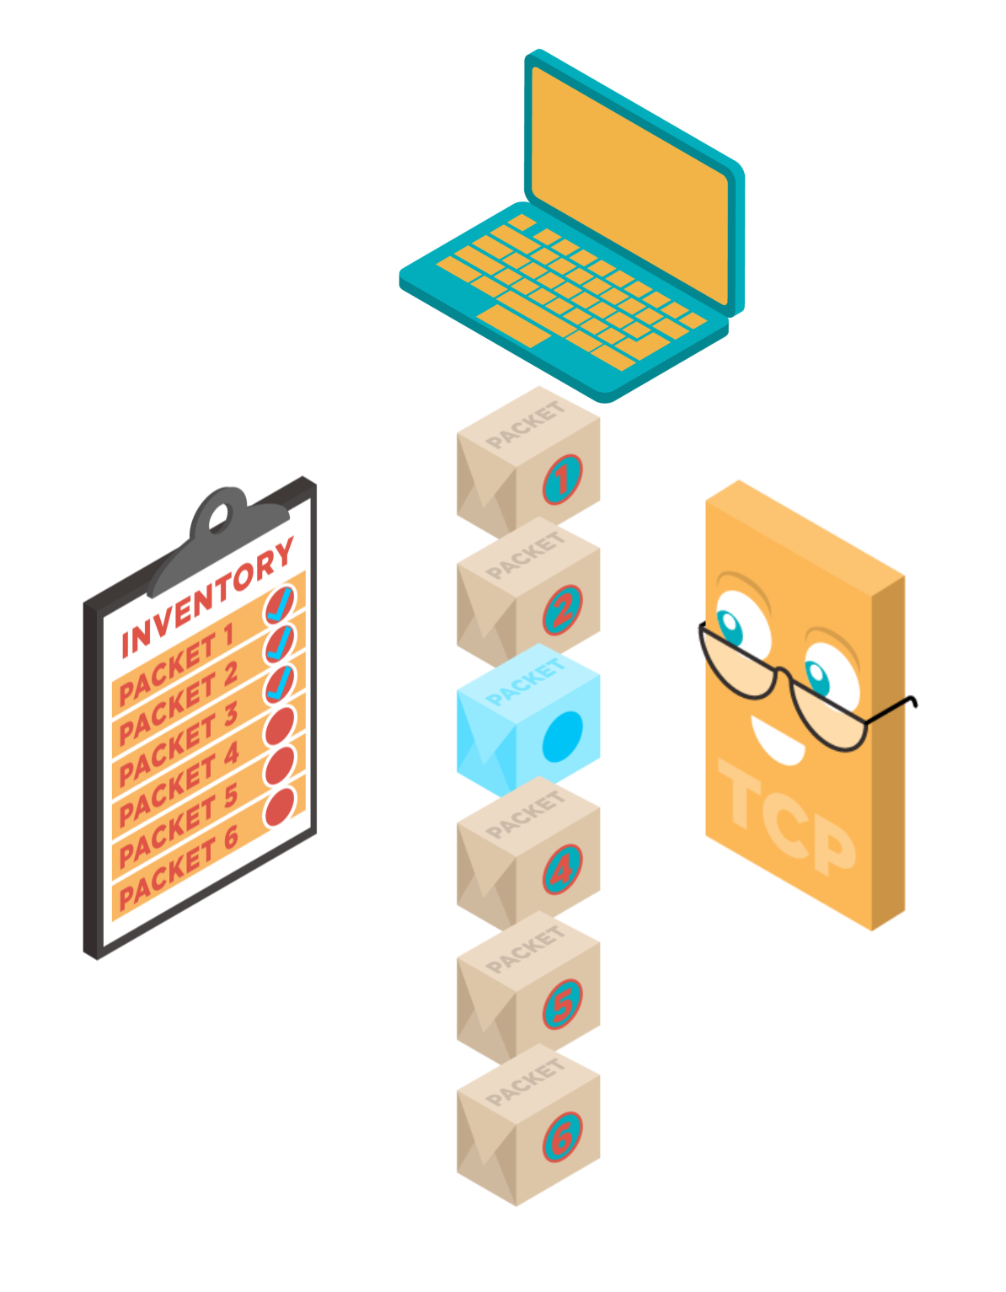
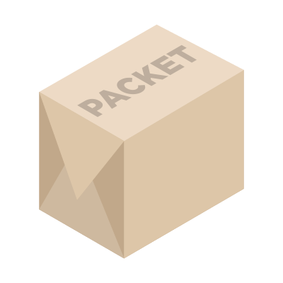
Unit 2 Lesson 5 - Wrap Up
Datastream: Information passed through the internet in packets.
Packet: A chunk of data sent over a network. Larger messages are divided into packets that may arrive at the destination in order, out-of-order, or not at all.
Packet Metadata: Data added to packets to help route them through the network and reassemble the original message.
The IP address of the sender and receiver helps route the message.
Transmission Control Protocol (TCP): A protocol for sending packets that does error-checking to ensure all packets are received and properly ordered
User Datagram Protocol (UDP): A protocol for sending packets quickly with minimal error-checking and no resending of dropped packets
X
X

Slide 14
Unit 2 - Lesson 6
HTTP and DNS

Slide 15
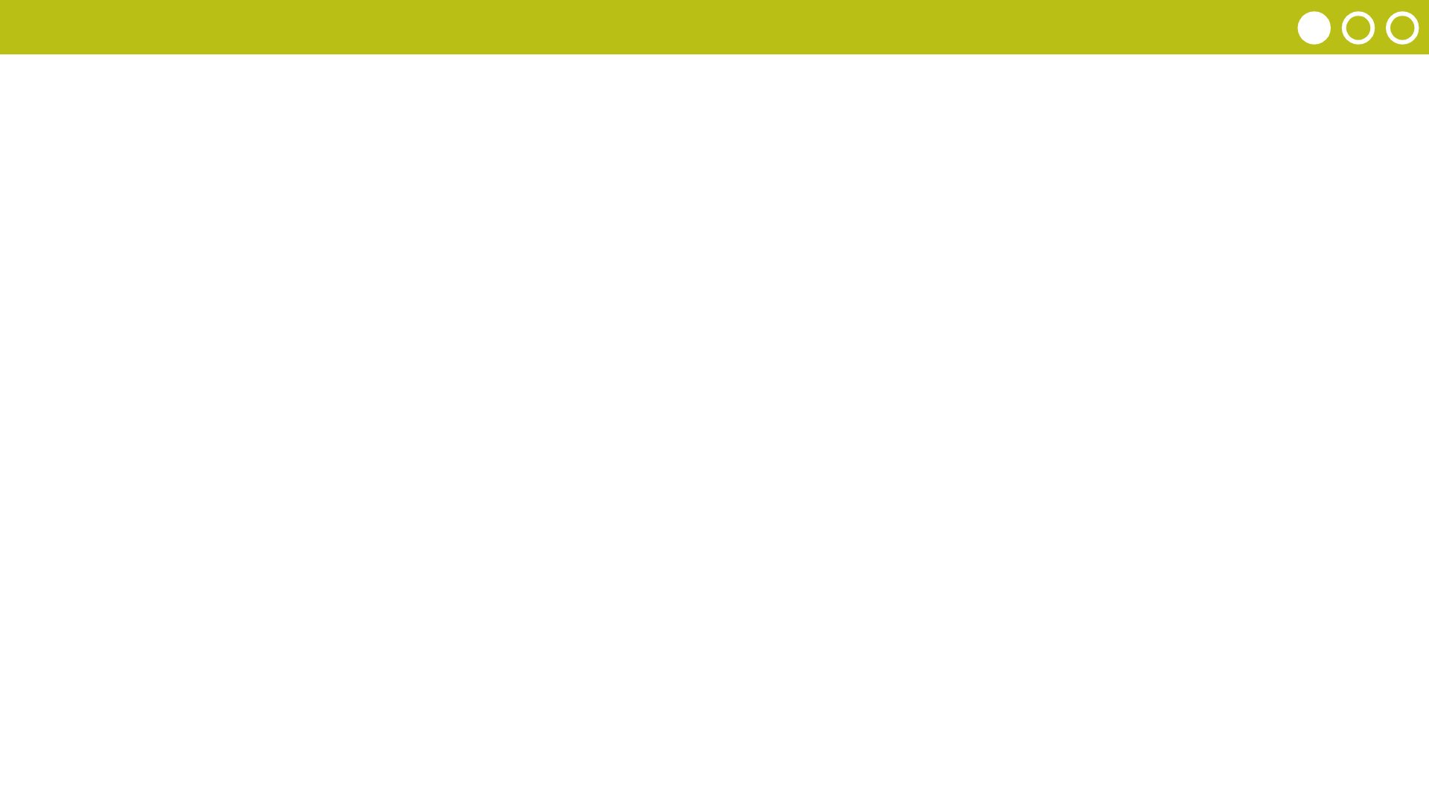
Unit 2 Lesson 6 - Warm Up
Prompt: Discuss with your classmates the following prompts
Why do you think I was switching your classmates’ IP addresses?
If IP addresses can change, is there a better way for everyone to know everyone else’s IP address?

Slide 16
Unit 2 Lesson 6 - Warm Up
Devices are joining and leaving the Internet all the time. IP addresses don't stay constant. If you go to a coffee shop or restart your browser your device might be assigned a new IP address.
If IP addresses are switching, it's very hard for each computer to keep an accurate list.
It would make more sense if there were one system that kept track of all that information.

Slide 17

Unit 2 Lesson 6 - Activity
AP CSP
Journal
How does the DNS solve the problem of translating domain names like example.com into IP addresses?
How does the DNS help the Internet scale?

Slide 18
Prompt: Discuss the following prompts with a partner:
How does the DNS solve the problem of translating domain names like example.com into IP addresses?
How does the DNS help the Internet scale?

Slide 19
The DNS is a network of servers that track the IP addresses of different domain names like example.com
When you visit a website you first ask the DNS for the IP address of the domain you want to visit. The first server to ask may have to ask other servers for this information.
This system allows billions of devices to get added to the network without putting pressure on any one computer or server to know all the IP addresses in the world.

Slide 20
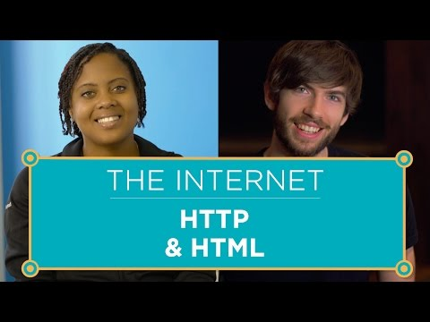
Unit 2 Lesson 5 - Activity
AP CSP
Journal
What problem is HTTP solving?
What is a GET request and what are your requesting?
How does HTTP rely on the other layers of the Internet?
Why are SSL, TLS, and HTTPS necessary?
What do certificate authorities do and why are they necessary?

Slide 21
Prompt: Review these questions with a partner about HTTP
What problem does it solve?
How does it work?
How does it rely on the other layers of the Internet?

Slide 22
When you visit a website you're actually getting sent a file by a server. HTTP is solving the problem of how to ask for that file.
Your computer and that server communicate using a protocol called HTTP.
HTTP is plain-text, so it literally includes the ASCII word "GET ..." and the file name requested.
All of your communications are being sent over the Internet so these requests are being sent inside TCP/IP packets and over the physical wires of the Internet.
There are other secure ways of sending information online because using HTTP, all our information would otherwise be sent as plain text.
Certificate authorities ensure that when you start a secure connection you're talking to the website you think you're talking to.

Slide 23
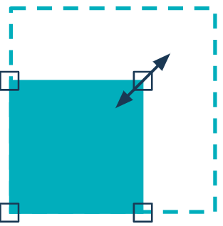
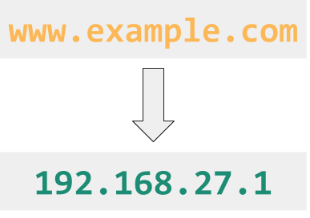
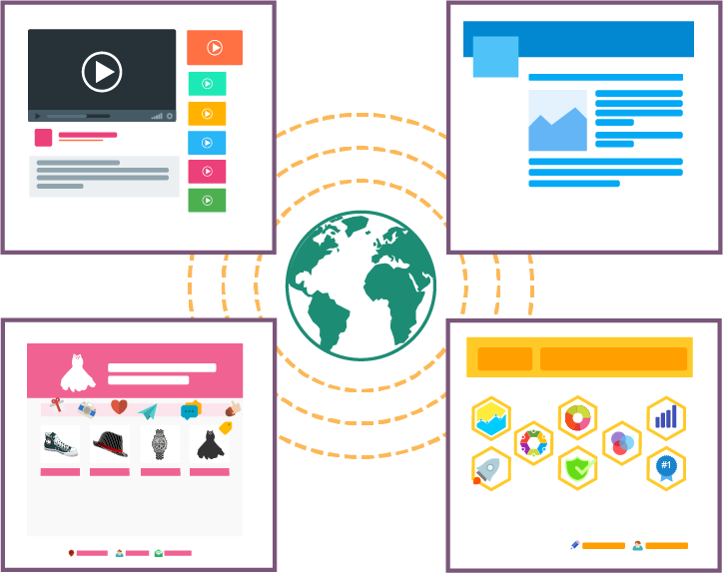
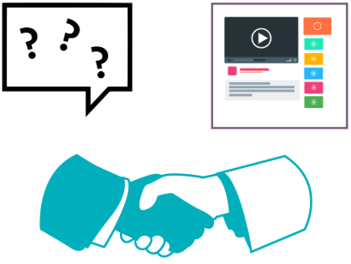
Unit 2 Lesson 6 - Wrap Up
Key Takeaways:
Scalability: the capacity for the system to change in size and scale to meet new demands
The Domain Name System (DNS): the system responsible for translating domain names like example.com into IP addresses
Hypertext Transfer Protocol (HTTP): a protocol for computers to request and share the pages that make up the world wide web on the Internet
World Wide Web: a system of linked pages, programs, and files
The World Wide Web is different from the Internet. The World Wide Web are files, web pages and media. The Internet is the network we use to access those files.
The DNS is an important system in helping the Internet scale.

Slide 24
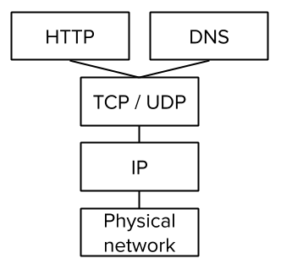
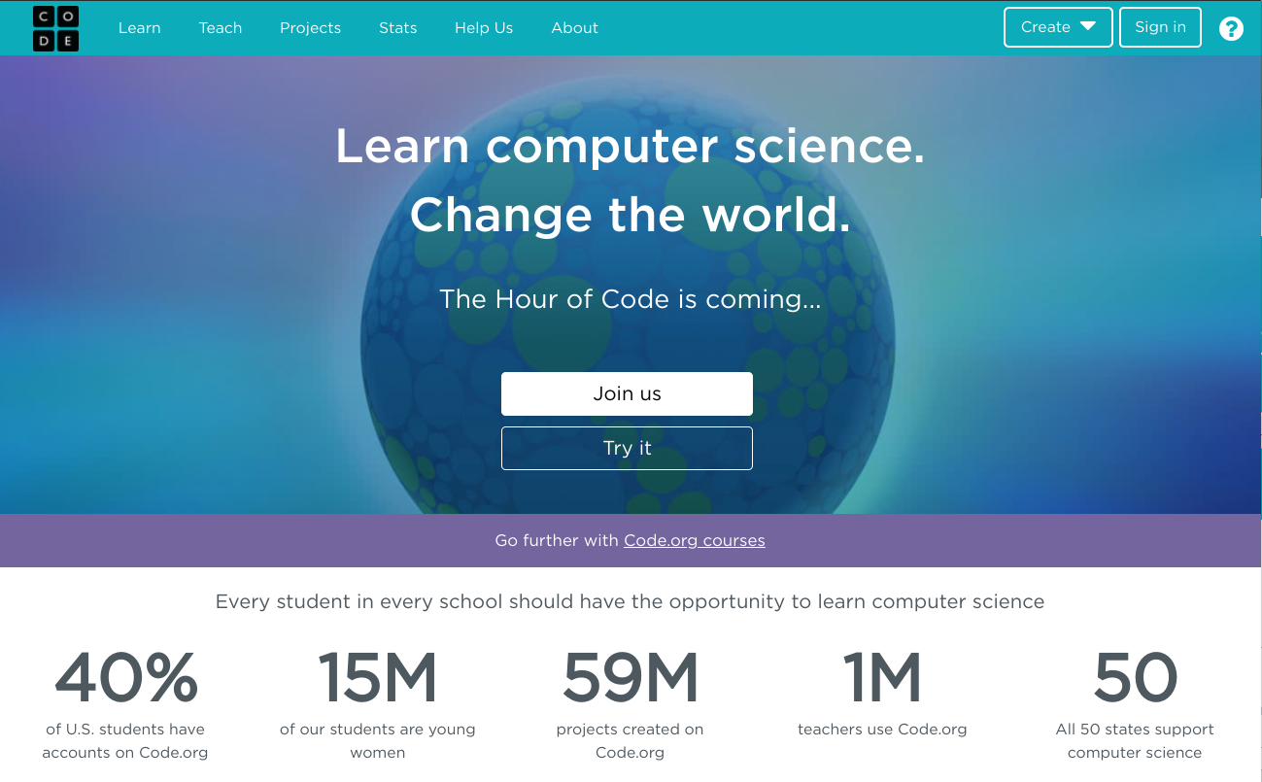
Unit 2 Lesson 6 - Wrap Up
Prompt:
Using your Layers of the Internet activity guide to help you, explain how each of the different layers is involved when you go to a link like code.org?
code.org

Slide 25
When you type in code.org, your browser will contact the DNS to find Code.org's IP address
When you receive the address you'll send an HTTP GET request to code.org to send you its homepage
Code.org's server will respond with the HTML code that makes up its web page
All of the communications above happen on the Internet which means TCP or UDP will break the message into packets and then send them. If TCP is used, error checking will occur.
IP will route the packets back and forth between your computer and the server
All of this information is sent over the physical wires, cable, wifi networks, and routers that make up the physical network of the internet.

Slide 26
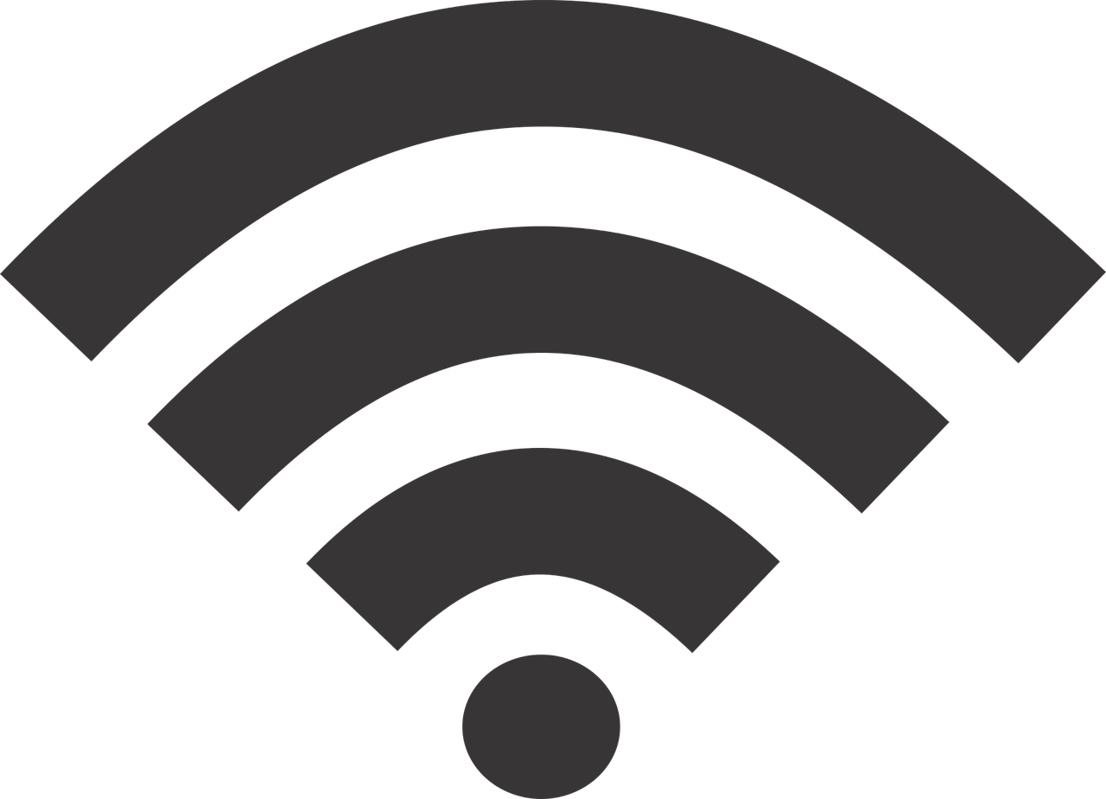
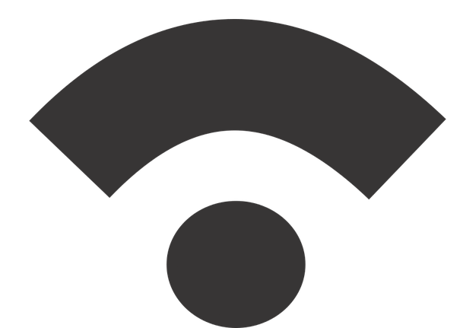




Unit 2 Lesson 7 - Wrap Up
Digital Divide - differing access to computing devices and the Internet, based on socioeconomic, geographic, or demographic characteristics.
Can affect both individual and groups.
Raises ethical concerns of equity, access, and influence globally and locally.
Affected by the actions of individuals, organizations, and governments.

